Slide 1
Chapter 4
Top-Down Parsing
LL(1) Parsing
Lijie Li
College of Computer Science & Technology
Harbin Engineering University

Slide 2
Introduction
No longer often used
Simple scheme with explicit stack
Prelude for more powerful and complex bottom-up algorithms
First “L” – the input is processed from left to right
Second “L” – leftmost derivation
1 – one lookahead symbol
LL(1) Parsing
Compiler

Slide 3
Top-Down Parsing
S → (S) S
S → ε
Example: Grammar: S → (S) S | ε String: ( )
Parsing stack
Input
Action
1
$ S
( ) $
S → (S) S
2
$ S ) S (
( ) $
Match
3
$ S ) S
) $
S → ε
4
$ S )
) $
Match
5
$ S
$
S → ε
6
$
$
accept
Compiler

Slide 4
Basic Method
Push the start symbol onto the stack.
Generate: Replace a nonterminal on the top of the stack by one of the choices in the grammar rule for that nonterminal.
  The replacement string from the BNF must be pushed in reverse onto the stack.
Match: Match a token on the top of the stack with the next input token (throw both away).
Repeat steps 2 and 3 . Accept if the stack and the input become empty.
Compiler

Slide 5
Parse Tree Construction
As the parse proceeds, we can add node construction actions as each nonterminal or terminal is pushed onto the stack.
The root node is constructed at the beginning of the parse.
(1) S => ( S ) S [ S → ( S ) S ]
(2) => ( ) S [ S → ε ]
=> ( ) [ S → ε ]
Leftmost derivation
Top-down parsing
Compiler

Slide 6
Top-Down Parsing
S → (S) S
S → ε
Example: Grammar: S → (S) S | ε String: ( )
Parsing stack
Input
Action
1
$ S
( ) $
S → (S) S
2
$ S ) S (
( ) $
Match
3
$ S ) S
) $
S → ε
4
$ S )
) $
Match
5
$ S
$
S → ε
6
$
$
accept
Compiler

Slide 7
Which Rule to Use?
When a nonterminal A is at the top of the parsing stack, a decision must be made based on the current input token (the lookahead).
Choices are expressed by LL(1) parsing table.
  This is a two dimensional array M[N, T] indexed by nonterminals N and terminals T ($ is added to terminals).
M[N, T]
(
)
$
S
S → (S) S
S → ε
S → ε
Compiler
Compiler

Slide 8
Rules
If A → α is production choice, and there is a derivation α =>* a β, where a is a token, then add A → α to the table entry M[A, a].
  Given a token a in the input, we select a rule A → α if α can produce an a for matching.
If A → α is production choice, and there is a derivations α =>* ε and S $ =>* β A a γ, where S is the start symbol and a is a token ( or $), then add A → α to the table entry M[A, a].
  If A derives an empty string, and if a is a token that can come after A, then we want to select A → α to make A disappear.
Compiler

Slide 9
Example
S → (S) S | ε
There is one nonterminal S, three tokens (, ) and $, and two production choices.
Every string derivable from S must be either empty or begin with (.
S → (S) S is added to M[S, ( ]
S → ε is added to M[S, )] and M[S, $]
1. A → α , α =>* a β
2. A → α, α =>* ε, S $ =>* β A a γ
M[N, T]
(
)
$
S
S → (S) S
S → ε
S → ε
Compiler

Slide 10
Example
M[N, T] | ( | ) | $
S | S → (S) S | S → ε | S → ε
Example: Grammar: S → (S) S | ε String: ( )
Parsing stack
Input
Action
1
$ S
( ) $
S →(S) S
2
$ S ) S (
( ) $
Match
3
$ S ) S
) $
S → ε
4
$ S )
) $
Match
5
$ S
$
S → ε
6
$
$
accept
Compiler

Slide 11
LL(1) Grammar
A grammar is LL(1) grammar if the associated LL(1) parsing table has at most one production rule in each table entry.
An LL(1) grammar cannot be ambiguous .
Compiler

Slide 12
Example
S → (S) S | ε
There is one nonterminal S, three tokens (, ) and $, and two production choices.
Every string derivable from S must be either empty or begin with (.
S → (S) S is added to M[S, ( ]
S → ε is added to M[S, )] and M[S, $]
1. A → α , α =>* a β
2. A → α, α =>* ε, S $ =>* β A a γ
M[N, T]
(
)
$
S
S → (S) S
S → ε
S → ε
Compiler

Slide 13
Problems with Recursive-Descent
It may be difficult to convert a grammar into EBNF.
It may be difficult to distinguish two or more grammar rule options A → α | β, if both α and β begin with nonterminals.
(First set)
3. A → ε. It may be necessary to know what token can come after the nonterminal A.
(Follow set)
Compiler

Slide 14
Example
Example: Grammar: S → (S) S | ε String: ( )
Parsing stack
Input
Action
1
$ S
( ) $
S →(S) S
2
$ S ) S (
( ) $
Match
3
$ S ) S
) $
S → ε
4
$ S )
) $
Match
5
$ S
$
S → ε
6
$
$
accept
Compiler

Slide 15
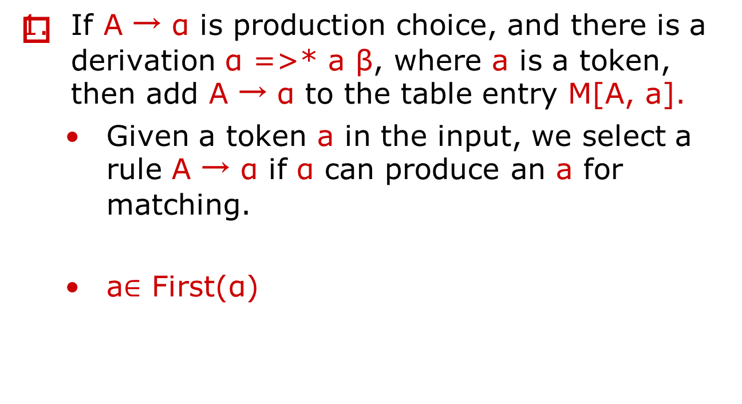
Rules
Compiler

Slide 16
Nullable Nonterminals
A nonterminal A is nullable if there exists a derivation A => *ε .
Theorem: A nonterminal is nullable if and only if First(A) contains ε.
Compiler

Slide 17
First Sets
Let X be a grammar symbol (terminal or nonterminal) or ε. Then the set First(X) consisting of terminals and ε, is defined as follows.
  If X is terminal or ε, then First(X) = {X}.
  If X is nonterminal, then for each production choice X→X₁ X₂ …X_{n},
    First(X) contains First(X₁) – ε.
    If also for some i < n, all the sets First(X₁), First(X₂), … First(X_{i}) contain ε, then First(X) contains First(X_{i+1}) – ε.
    If all of the sets First(X₁), First(X₂), …, First(X_{n}) contain ε, then First(X) also contains ε.
X₁ X₂…X_{i-1} X_{i} X_{i+1}…X_{n-1} X_{n}
Compiler

Slide 18
First Sets (cont)
Define First(α) for any string α = X₁ X₂ …X_{n} (a string of terminals and nonterminals) as follows.
  First(α) contains First(X₁) – ε.
  For each i = 2, 3, … n, if First(X_{k}) contains ε for k = 1, 2, … i-1, then First(α) contains First(X_{i}) – ε.
  If for all i = 1, 2, … n, First(X_{i}) contains ε, then First(α) contains ε.
X₁ X₂…X_{i-1} X_{i} X_{i+1}…X_{n-1} X_{n}
Note: In absence of ε -productions, the only rule is the rule 1.
Compiler

Slide 19
Example 4.9
exp → exp addop term | term
addop → + | -
term → term mulop factor| factor
mulop → *
factor → (exp) | number
exp → exp addop term
exp → term
addop → +
addop → -
term → term mulop factor
term → factor
mulop → *
factor → (exp)
factor → number
Rewrite each choice separately.
Note, there is no ε -productions.
Compiler

Slide 20
Example 4.9 (cont)
exp → exp addop term
exp → term
addop → +
addop → -
term → term mulop factor
term → factor
mulop → *
factor → (exp)
factor → number
First(exp) = { }
First (addop) = { }
First(term) = { }
First(mulop) = { }
First(factor) = { }
（ , number
+
, -
（ , number
*
（
, number
Compiler

Slide 21
Example 4.10
statement → if-stmt | other
if-stmt → if (exp) statement else-part
else-part → else statement | ε
exp → 0 | 1
statement → if-stmt
statement → other
if-stmt → if (exp) statement else-part
else-part → else statement
else-part → ε
exp → 0
exp → 1
Compiler

Slide 22
Example 4.10 (cont)
statement → if-stmt
statement → other
if-stmt → if (exp) statement else-part
else-part → else statement
else-part → ε
exp → 0
exp → 1
First(statement) = { }
First(if-stmt) = { }
First(else-part) = { }
First(exp) = { }
if,
other
if
else
, ε
0
, 1
Compiler

Slide 23
Example 4.11
stmt-sequence → stmt stmt-seq’
stmt-seq’ → ; stmt-sequence | ε
stmt → s
stmt-sequence → stmt stmt-seq’
stmt-seq’ → ; stmt-sequence
stmt-seq’ → ε
stmt → s
Compiler

Slide 24
Example 4.11
stmt-sequence → stmt stmt-seq’
stmt-seq’ → ; stmt-sequence
stmt-seq’ → ε
stmt → s
First(stmt-sequence) = { }
First(stmt-seq’) = { }
First(stmt) = { }
s
;
, ε
s
Compiler

Slide 25
Example
A → BA*|B
B → a | (A)| ε
A → BA*
A → B
B → a
B →(A)
B → ε
Compiler

Slide 26
Example
A → BA*
A → B
B → a
B →(A)
B → ε
First(A) = {a,(, ε ,* }
First(B)= {a,(, ε }
Compiler

Slide 27
Problems with Recursive-Descent
It may be difficult to convert a grammar into EBNF.
It may be difficult to distinguish two or more grammar rule options A → α | β, if both α and β begin with nonterminals.
(First set)
3. A → ε. It may be necessary to know what token can come after the nonterminal A.
(Follow set)
Compiler

Slide 28
Example
Example: Grammar: S → (S) S | ε String: ( )
Parsing stack
Input
Action
1
$ S
( ) $
S →(S) S
2
$ S ) S (
( ) $
Match
3
$ S ) S
) $
S → ε
4
$ S )
) $
Match
5
$ S
$
S → ε
6
$
$
accept
Compiler

Slide 29
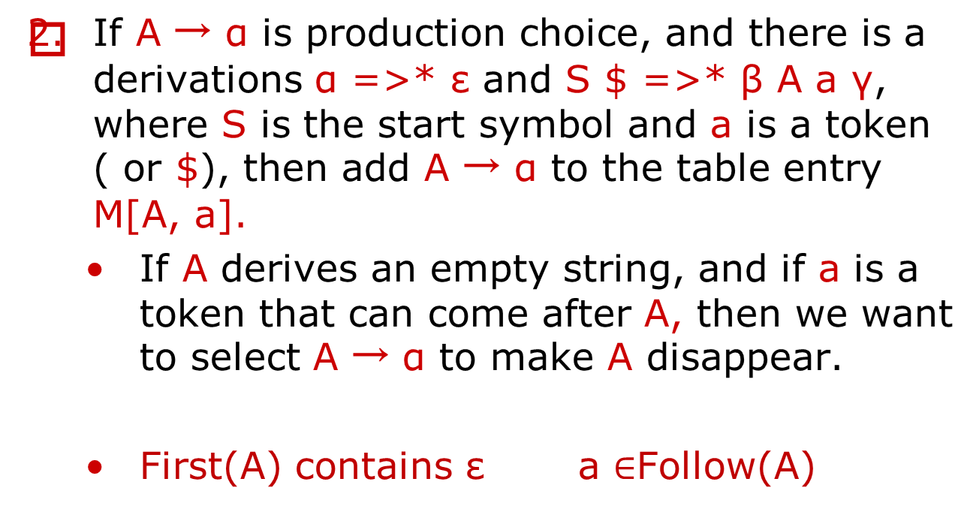
Rules
Compiler

Slide 30
Follow Sets
Given a nonterminal A, the set Follow(A), consisting of terminals and $, is defined as follows.
  If A is the start symbol, then $ is in Follow(A).
  If there is a production B → α A γ, then First(γ) – ε is in Follow(A).
  If there is a production B → α A γ such that ε is in the First(γ), then Follow(A) contains Follow(B).
    If B → α A, Follow(A) contains Follow(B)
Compiler

Slide 31
Example 4.9
exp → exp addop term | term
addop → + | -
term → term mulop factor | factor
mulop → *
factor → (exp) | number
exp → exp addop term
exp → term
addop → +
addop → -
term → term mulop factor
term → factor
mulop → *
factor → (exp)
factor → number
Rewrite each choice separately.
Note, there is no ε -productions.
Compiler

Slide 32
Example 4.12
exp → exp addop term
exp → term
addop → +
addop → -
term → term mulop factor
term → factor
mulop → *
factor → (exp)
factor → number
First(exp) = { ( , number}
First (addop) = {+, - }
First(term) = { ( , number}
First(mulop) = { * }
First(factor) = { ( , number}
Follow(exp) = { }
Follow(addop) = { }
Follow(term) = { }
Follow(factor) = { }
Follow(mulop) = { }
$
, +, -
, )
( , number
$, +, -
, *
, )
$, +, - , *
, )
( , number
Compiler

Slide 33
Example 4.10
statement → if-stmt | other
if-stmt → if (exp) statement else-part
else-part → else statement | ε
exp → 0 | 1
statement → if-stmt
statement → other
if-stmt → if (exp) statement else-part
else-part → else statement
else-part → ε
exp → 0
exp → 1
Compiler

Slide 34
Example 4.13
statement → if-stmt
statement → other
if-stmt → if (exp) statement else-part
else-part → else statement
else-part → ε
exp → 0
exp → 1
First(statement) = {if, other}
First(if-stmt) = { if }
First(else-part) = { else, ε}
First(exp) = {0, 1}
Follow(statement) = { }
Follow(if-stmt) = { }
Follow(else-part) = { }
Follow(exp) = { }
$
, else
$
, else
$
, else
)
Compiler

Slide 35
Example 4.11
stmt-sequence → stmt stmt-seq’
stmt-seq’ → ; stmt-sequence | ε
stmt → s
stmt-sequence → stmt stmt-seq’
stmt-seq’ → ; stmt-sequence
stmt-seq’ → ε
stmt → s
Compiler

Slide 36
Example 4.14
stmt-sequence → stmt stmt-seq’
stmt-seq’ → ; stmt-sequence
stmt-seq’ → ε
stmt → s
First(stmt-sequence) = { s }
First(stmt-seq’) = { ; , ε}
First(stmt) = { s }
Follow(stmt-sequence) = { }
Follow(stmt-seq’) = { }
Follow(stmt) = { }
$
$
;
, $
Compiler

Slide 37
Example
A → BA*|B
B → a | (A)| ε
A → BA*
A → B
B → a
B →(A)
B → ε
Compiler

Slide 38
Example
A → BA*
A → B
B → a
B →(A)
B → ε
First(A) = {a,(, ε ,* }
First(B)= {a,(, ε }
Follow(A) = {$,* ,) }
Follow(B ) = {a,(, *, $,) }
Compiler

Slide 39
Constructing LL(1) Parsing Tables
If A → α is production choice, and there is a derivation α =>* a β, where a is a token, then add A → α to the table entry M[A, a].
  Given a token a in the input, we select a rule A -> α if α can produce an a for matching.
  The token a is in First(α)
If A → α is production choice, and there is a derivations α =>* ε and S $ =>* β A a γ, where S is the start symbol and a is a token ( or $), then add A → α to the table entry M[A, a].
  If A derives an empty string, and if a is a token that can come after A, then we want to select A -> α to make A disappear.
  The token a is in Follow(A)
Compiler

Slide 40
LL(1) Parsing Table Algorithm
Repeat the following two steps for each nonterminal a and production choice A → α.
  For each token a in First(α), add A → α to the entry M[A,a].
  If ε is in First(α), for each element a of Follow(A), add A → α to M[A,a].
Compiler

Slide 41
Example
S → (S) S
S → ε
S → (S) S | ε
First( S ) = { }
Follow( S ) = { }
S → (S) S is added to M[S, ( ]
S → ε is added to M[S, )] and M[S, $]
(
, ε
$
, )
M[N, T]
(
)
$
S
S → (S) S
S → ε
S → ε
Compiler

